Slide 1

Bounding Volumes
Pure3D v17
A Refresher Course for using
Pure3D Bounding Volumes
in Maya.
12 June 2002

Slide 2

Introduction
Recent changes & additions
Using the 4-point box
Physics Attributes
Previewing in p3dView
Exporter errors and warnings
Known bugs and limitations

Slide 3
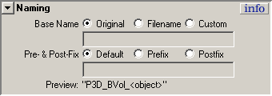
What’s New?
Custom Naming options
  All new and existing Bounding Volumes will use the specified naming scheme.

Slide 4
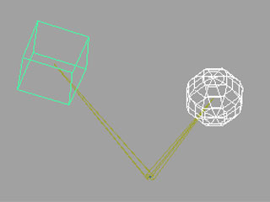
What’s New?
Tandem scaling via a Bounding Node
  Bounding Volumes may now be scaled uniformly as a group when placed under a Bounding Node.

Slide 5
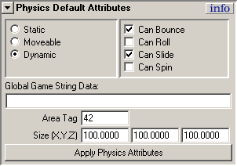

What’s New?
“Smart” ‘Apply Physics Attributes’ button.
  Tells you what node will inherit Physics Attributes.
  Dims when current selection is not valid.

Slide 6

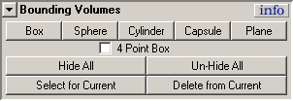
4-Point Box
Allows you define the edge, bottom and height for a Box Bounding Volume
Precise, aligned placement

Slide 7
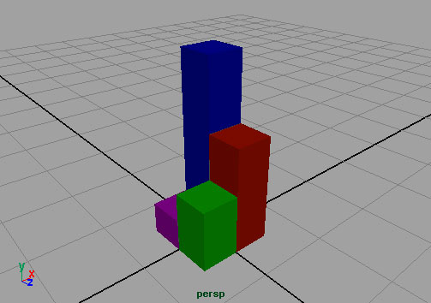
4-Point Box
Our unsuspecting object…

Slide 8
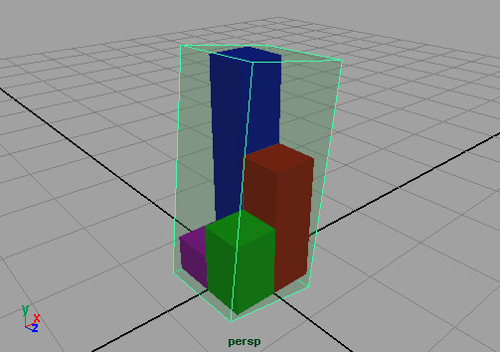
4-Point Box
Default Box tries too hard to compensate.

Slide 9
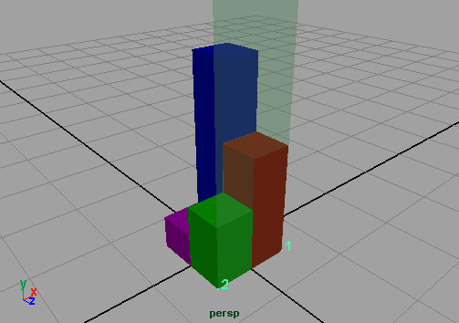
4-Point Box
First two points define edge of Box.

Slide 10
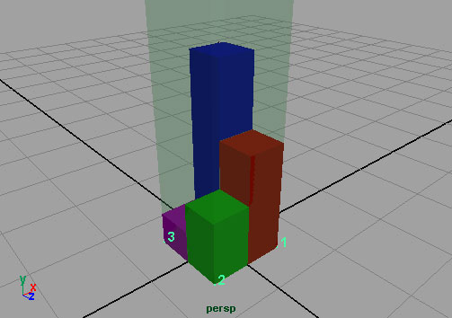
4-Point Box
Third point defines bottom plane.

Slide 11
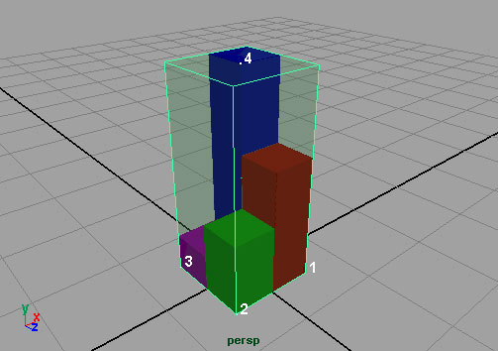
4-Point Box
Fourth point defines height
and completes Box.

Slide 12
Physics Attributes
Defines the behavior for the geometry to which the Bounding Volumes are assigned.
Primary modes:
  Static
  Moveable
  Dynamic

Slide 13

Physics Attributes
Physics Attributes are not stored on the Bounding Volume node!
Stored on shape node.
In the case of a Composite Drawable they are stored on the Skeleton Root transform node.

Slide 14
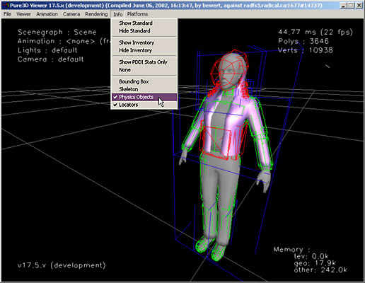
p3dView

Slide 15
Exporter Warnings
// Warning: Bounding Volume has no drawable Owner. //
Bounding Volume is attached to a Joint which contributes no influence to the vertices in the skin.
Use ‘selectJointVertices.mel’ to illustrate.

Slide 16
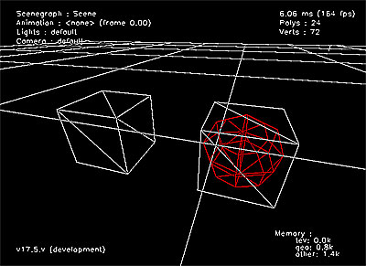
Limitations
Instanced Bounding Volumes cannot be previewed in p3dView.
Stand-alone Bounding Volumes cannot be previewed in p3dView.

Slide 17
Summary
Use the 4-point box for geometry-hugging collision volumes.
Physics Attributes are not found on Bounding Volume nodes.
p3dView can show Bounding Volumes, but won’t necessarily show everything.
Watch for Exporter warnings.

Slide 18
Comments?
Email: pure3dfeedback@radical.ca
Log bugs using PVCS Tracker

